Slide 1
MATH23 MULTIVARIABLE CALCULUS
Prof. Francis Llacuna
2010-2011, 2nd quarter

Slide 2
VECTORS

Slide 3
Rectangular SPACE COORDINATEs

Slide 4
Rectangular Coordinate System
The three dimensional rectangular coordinate system consists of three mutually perpendicular coordinate lines, called the x-axis, the y-axis, and the z-axis.
The system fall into two categories: left-handed and right-handed.
The coordinate axes, taken in pairs, determine three coordinate planes: the xy-plane, the xz-plane, and the yz-plane.
The coordinate planes divide the system into eight parts, called octants. The set of points with three positive coordinates forms the first octant; the remaining octants have no standard numbering.
In this system, a point is placed in one-to-one correspondence with triple of real numbers, say P (a, b, c).

Slide 5
Vectors in Three Dimensional Space
A vector v is represented geometrically by arrow in 2-space or 3-space; the direction of the arrow specifies the direction of the vector, and the length of the arrow describes the magnitude. The tail of the arrow is called the initial point of the vector, and the tip of the arrow the terminal point.
Vector with Initial Point at the Origin
A vector v is positioned with its initial point at the origin and terminal point (v₁ , v₂ ) or (v₁ , v₂ , v₃ ). The coordinates of the terminal point of v are called the components of v. Thus,
v = <v₁ , v₂ > or v = <v₁ , v₂ , v₃ >

Slide 6
Vectors in Three Dimensional Space
Vector with Initial Point not at the Origin
Theorem: If P₁ P₂ is a vector in 2-space with initial point P₁ (x₁ , y₁) and terminal point P₂ (x₂ , y₂ ), then
P₁ P₂ = <x₂ – x₁ , y₂ – y₁>
Similarly, if P₁ P₂ is a vector in 3-space with initial point P₁ (x₁ , y₁, z₁ ) and terminal point P₂ (x₂ , y₂ , z₂ ), then
P₁ P₂ = < x₂– x₁ , y₂ – y₁ , z₂ - z₁>

Slide 7
.

Slide 8
Vectors in Three Dimensional Space
Properties:
1. Equal (equivalent) vectors
Two vectors, v and w, are equal (also called equivalent) if they have the same length and same direction.
Geometrically, two vectors are equal if they are translations of one another or they are in different positions.
2. Arithmetic Operations on Vectors
If v = <v₁ , v₂ > and w = <w₁ , w₂ > are vectors in 2-space and k is any scalar, then

Slide 9
Vectors in Three Dimensional Space
a) v + w = <v₁ + w₁ , v₂ + w₂ >
b) v – w = <v₁ – w₁ , v₂ – w₂ >
c) kv = <kv₁ , kv₂>
Similarly, if v = <v₁ , v₂ , v₃ > and w = <w₁ , w₂ , w₃ > are vectors in 3-space and k is any scalar, then
a) v + w = <v₁ + w₁ , v₂ + w₂ , v₃ + w₃ >
b) v – w = <v₁ – w₁, v₂ – w₂, v₃ – w₃>
c) kv = <kv₁ , kv₂, kv₃>

Slide 10
Vectors in Three Dimensional Space
3. Norm of a Vector
The distance between the initial and terminal points of a vector v is called the length, the norm, or the magnitude of v and is denoted by ǁvǁ.
4. Unit Vector
A vector of length 1 is called a unit vector.
The vectors i and j in 2 space: i = <1, 0>, j = <0, 1>
The vectors i, j, and k in 3-space: i = <1, 0, 0>, j = <0, 1, 0>, k = <0, 0, 1>

Slide 11
Vectors in Three Dimensional Space
5. Normalizing a Vector
- Process of multiplying a vector by the reciprocal of its length to obtain a unit vector with the same direction.
u = (1/ǁvǁ) v = v/ǁvǁ
6. Vector Determined by Length and Angle
v = ǁvǁ <cos θ , sin θ> = ǁvǁ cos θ i + ǁvǁ sin θ j
where v is a nonzero vector with its initial point at the origin and θ is the angle from the positive x-axis.

Slide 12
Vectors in Three Dimensional Space
For a unit vector u,
u =< cos θ , sin θ > = cos θ i + sin θ j
7. Vector Determined by its Length and a Unit Vector in the Same Direction
v = ǁvǁ u

Slide 13
Exercise Set 11.2
Sketch the vectors with their initial points at the origin.
1. b) <-5, 4> e) 3i – 2j 3. b) <2, 2, -1> d) 2i + 3j – 2k
6. Find the components of the vector AB and sketch an equivalent vector with its initial point at the origin.
a) A (2, 3), B (-3, 3) b) A (3, 0, 4), B (0, 4, 4)
10. a) Find the terminal point of v = <7, 6> if the initial point is (2, -1).
b) Find the terminal point of v = i + 2j – 3k if the initial point is (-2, 1, 4).
12. Perform the stated operations on the given vectors u = <2, -1, 3>, v = <4, 0, -2>, and w = <1, 1, 3>.
f) 2v – (u + w)

Slide 14
Exercise Set 11.2
14. Find the norm of v.
a) v = <3, 4> d) v = i + j + k
22. Find unit vectors that satisfy the stated conditions.
a) Oppositely directed to 3i – 4j.
b) Same direction as 2i – j – 2k.
c) Same direction as the vector from the point A (-3, 2) to the point B (1, -1).
24. Find the vectors that satisfy the stated conditions.
a) Same direction as v = -2i + 3j and three times the length of v.
b) Length 2 and oppositely directed to v = -3i + 4j + k.

Slide 15
Exercise Set 11.2
26. Find the component forms of v + w and v – w in 2-space, given that ǁvǁ = 1, ǁwǁ = 1, v makes an angle of π/6 with the positive x-axis, and w makes an angle of 3 π/4 with the positive x-axis.
32. Let u =<-1, 1>, v =<0,1>, and w = <3, 4>. Find the vector x that satisfies u – 2x = x – w + 3v.
34. Find u and v if u+ v = <2, -3> and 3u + 2v = <-1, 2>.

Slide 16
The Dot (Scalar) Product
Definition:
If u = <u₁, u₂ > and v = <v ₁, v₂> are vectors in 2-space, then the dot product of u and v, written as u.v, is defined as
u.v = u₁ v₁ + u₂ v₂
Similarly, if u = <u₁ , u₂ , u₃ > and v = <v₁ , v₂, v₃ > are vectors in 3-space, then their dot product is defined as
u.v = u₁ v₁ + u₂ v₂ + u₃ v₃

Slide 17

DOT PRODUCT (Scalar Product)
Algebraic Properties of the Dot Product
Theorem:
If u, v, and w are vectors in 2-space or 3-space and k is a scalar, then
a) u.v = v.u b) u.(v + w) = u.v + u.w
c) k(u.v) = (ku).v d) v.v = ǁ${vǁ}^{2}$
e) 0.v = 0
Angle Between Vectors
Theorem:
If u and v are nonzero vectors in 2-space or 3-space, and if θ is the angle between them, then

Slide 18
DOT PRODUCT (Scalar Product)
cos θ = (u.v)/ǁuǁ ǁvǁ
Note: If u.v > 0, θ is an acute angle. If u.v < 0 , θ is an obtuse angle. If u.v = 0, θ is a right angle.
Direction Angles
In an xy-coordinate system, the direction of a nonzero vector v is determined by the angles α and β between v and the unit vectors i and j, and in an xyz-coordinate system, the direction is determined by the angles α, β, and γ between v and the unit vectors i, j, and k. In both 2- space and 3-space, the angles between a nonzero vector v and the vectors i , j, and k are called the direction angles of v, and the cosines of those angles are called the direction cosines of v.

Slide 19

The Dot (Scalar) Product
Theorem:
The direction cosines of a nonzero vector v = v i + v j + v k are
cos α = v₁ / ǁvǁ , cos β = v₂ / ǁvǁ cos γ = v₃ / ǁvǁ
Note: cos² α + $\cos^{2}$ β + $\cos^{2}$ γ = 1

Slide 20
Exercise Set 11.3
1. Find the dot product of the vectors and the cosine of the angle between them.
b) u = <-7, 3>, v = <0, 1>
c) u = 1- 3j + 7k, v = 8i – 2j – 2k
2. Find u.v if ǁuǁ = 1, ǁvǁ = 2, the angle between u and v is π/6.
3. Determine whether u and v make an acute angle, an obtuse angle, or are orthogonal.
b) u = 6i +j + 3k, v = 4i – 6k
7. b) Use vectors to find the interior angles of the triangle with vertices (-1, 0), (2, -1), and (1, 4).

Slide 21
Exercise Set 11.3
13. Find r so that the vector from the point A (1, -1, 3) to the point B (3, 0, 5) is orthogonal to the vector from A to the point P (r, r, r).
16. Find the direction cosines and direction angles of a) v = 3i – 2j – 6. b) v = 3i – 4k.

Slide 22
The Cross (Vector) Product
Definition.
If u = <u₁ , u₂ , u₃> and v = <v₁ , v₂ , v₃> are vectors in 3-space, then the cross product u x v is the vector defined by
u u u u u u
u x v = i j k
v v v v v v
or, equivalently,
u x v = (u v – u v ) i – (u v – u v ) j + (u v – u v) k

Slide 23
The Cross (Vector) Product
Algebraic Properties of the Cross Product
Theorem: If u, v, and w are any vectors in 3-space and k is any scalar, then:
a) u x v = - (v x u)
b) u x (v + w) = (u x v) + (u x w)
c) (u + v) x w = ( u x w) + (v x w)
d) k(u x v) = (ku) x v = u x (kv)
e) u x 0 = 0 x u = 0
f) u x u = 0

Slide 24
The Cross (Vector) Product
Geometric Properties of the Cross Product
Theorem:
1. If u and v are vectors in 3-space, then:
a) u. (u x v) = 0 (u x v is orthogonal to u)
b) v. (u x v) = 0 (u x v is orthogonal to v)
2. Let u and v be nonzero vectors in 3-space, and let θ be the angle between these vectors when they are positioned so their initial points coincide.
a) ǁu x vǁ = ǁuǁ ǁvǁ sinθ
b) The area A of a parallelogram that has u and v as adjacent sides is
A = ǁ u x v ǁ
c) u x v = 0 if and only if u and v are parallel vectors, that is, if and only if they are scalar multiples of one another.

Slide 25

The Scalar Triple Products
Definition:
If $u= <u_{1}$, $u_{2}$, $u_{3}$ >, $v= <v_{1}$, $v_{2}$, $v_{3}$ >, and $u= <u_{1}$, $u_{2}$, $u_{3}$ > are vectors in 3-space, then the number
$u . (v x w )$
is called the scalar triple product of $u, v and w$.
$u . \left(v x w \right)= \begin{matrix}u_{1} & u_{2} & u_{3} \\ v_{1} & v_{2} & v_{3} \\ w_{1} & w_{2} & w_{3}\end{matrix}$

Slide 26

The Scalar Triple Product
Geometric Properties:
If $u, v and w$ are nonzero vectors in 3-space that are positioned so their initial points coincide, then these vectors form the adjacent sides of a parallelepiped.
Theorem: Let u, v and w be nonzero vectors in 3-space.
a) The volume V of the parallelepiped has u, v and w as adjacent sides is
$V=│u . (v x w)$│
b) u . ( v x w ) = 0 if and only if u, v, and w lie in the same plane.
Algebraic Properties:
1. u . (v x w) = w. (u x v) = v. (w x u)
2. u. (v x w) = (u x v) . w or u.v x w = u x v . w

Slide 27
Exercise Set 11.4
4. Find u x w and check that it is orthogonal to both u = 3i +2j - k and v = - 1i – 3j + k.
7. Let u = <2, -1, 3>, v =<0, 1, 7> and w = <1, 4, 5>. Find a) u x ( v x w) b) (u x v) x (v x w)
10. Find two unit vectors that are orthogonal to both u = -7i + 3j + k, v = = 2i + 4k.
18. Find the area of the parallelogram that has u = 2i + 3j and v = -1i + 2j – 2k as adjacent sides.
20. Find the area of the triangle with vertices P(2, 0, -3), Q(1, 4, 5), R(7, 2, 9).
24. Find u . (v x w) where u = i, v = i + j, w = i + j + k
26. Find the volume of the parallelepiped that has u = 3i + j + 2k, v = 4i + 5j + k, w = i + 2j + 4k.

Slide 28

Exercise Set 11.4
27b. Determine whether the vectors u = 5i – 2j + k, v = 4i – j + k, w = i - j lie in the same plane.
30. Show that in 3-space, the distance d from a point P to the line L through points A and B can be expressed as
$d= \frac{ǁAP x ABǁ}{ǁABǁ}$
31. Find the distance between the point P (-3, 1, 2) and the line through the points A(1, 1, 0) and B (-2, 3, -4).
32. Find the volume of the tetrahedron with vertices P(-1, 2, 0), Q(2, 1, -3) R(1, 0, 1), S (3, -2, 3).

Slide 29

Line in Space
Parametric Equations of a Line
- provide the most convenient form for representing lines algebraically.
Line determined by a Point and a Vector
Consider a line L in 3-space that passes through the point and is parallel to the nonzero vector v = <a, b, c>. The point P (x, y, z) is on L if and only if $P_{0}P$ is a scalar multiple of v, say
$P_{0}P$ = t v
or $<{x −x}_{0}, y − y_{0},z −z_{0}> = <ta, tb, tc>$
which implies that
$x − x_{0}$ = at , y – $y_{0}$ = at, z – $z_{o}$ = at
Thus, $x= x_{0}+at, y= y_{0}+at, z=z_{0}+at$

Slide 30
Line in Space
Theorem:
a) The line in 2-space that passes through the point and is parallel to the nonzero vector v = <a, b> = ai + bj has parametric equatons
b) The line in 3-space that passes through the point and is parallel to the nonzero vector v = <a, b, c> = ai + bj + ck has parametric equations

Slide 31
Line in Space
Parametric Equations of a Line Segment
Obtained by finding parametric equations for the entire line, and then restricting the parameter so that only the desired segment is generated.
Vector Equation of a Line
- vector notation can express the parametric equations of a line more compactly.
<x, y> =
<x, y, z> =
Or, equivalently, as
<x, y> =
<x, y, z> =

Slide 32
Line in Space
In 2-space :
In 3-space:
Subsituting,
r + r + tv
Note: Two lines in 3-space that are not parallel and do not intersect are called skew lines. Any two skew lines lie in parallel planes.

Slide 33

Exercise Set 11.5
4a. Find parametric equations for the line through $P_{1} \left(−1, 3, 5\right)and P_{2} \left(−1, 3, 2\right).$
6b. Find parametric equations for the line whose vector equation is <x, y, z> = <-1, 0, 2> + t <-1, 3, 0>.
8b. Find a point P on the line and a vector v parallel to the line xi + yj + zk = (1i + j – 2k) + tj.
10. Express the given parametric equations of a line x = t, y = -2 + t using bracket notation and i, j k notation.

Slide 34

Exercise Set 11.5
Find parametric equations of the line that satisfies the stated conditions.
16. The line through (0, 3) that is parallel to the line x = -5 + t, y = 1 – 2t.
18. The line is tangent to the parabola y = $x^{2}$ at the point (-2, 4).
20. The line through (2, -1, 5) that is parallel to (-1, 2, 7).
22. The line through the origin that is parallel to the line given by x = t, y = -1 + t, z = 2.

Slide 35

Exercise Set 11.5
24. Where does the line <x, y> = <4t, 3t> intersect the circle $x^{2}+ y^{2}=25?$
26. Find the intersections of the line x = -1 + t, y = 3 + t, z = 4 – t with the xy-plane, the xz-plane, and the yz-plane.
52. Let L be the line that passes through the point ( ) and is parallel to the vector v = <a, b, c>, where a, b, and c are nonzero. Show that a point (x, y, z) lies on the line L if and only if
$\frac{x − x_{0} }{a}$ = $\frac{y − y_{0}}{b}= \frac{z − z_{0}}{c}$
These equations, which are called the symmetric equations of L, provide a nonparametric representation of L.

Slide 36
Exercise Set 11.5
54. Consider the lines L and L whose symmetric equations are
a) Are L and L parallel? Perpendicular?
b) Find parametric equations for L and L ?
c) Do L and L intersect? If so, where?

Slide 37
Exercise Set 11.5
30. Show that the lines L : x + 1 = 4t, y – 3 = 4t, z – 1 = 0 and L : x + 13 = 12t, y – 1 = 6t, z – 2 = 3t intersect, and find their point of intersection.
32. Show that the lines L : x = 2 + 8t, y = 6 – 8t, z = 10t and L : x = 3 + 8t, y = 5 – 3t, z = 6 + t are skew lines.
34. Determine whether the lines L : x = 5 + 3t, y = 4 – 2t, z = -2 + 3t and L : x = -1 + 9t, y = 5 – 6t, z = 3 + 8t are parallel.
38. Show that the lines L : x = 1 + 3t, y = -2 + t, z = 2t and L : x = 4 – 6t, y = -1 – 2t, z = 2 -= 4t are the same.
36. Determine whether the points P (1, 0, 1), P(3, -4, -3), and P (4, -6, -5) lie on the same line.
44. Describe the line segment represented by the vector equation <x, y, z> = <-2, 1, 4> + t <3, 0, -1> (0 ≤ t ≤ 3)

Slide 38
Plane in Space
A. Plane Parallel to the Coordinate Planes
1. x = a : plane through (a, 0, 0) that is parallel to the yz-plane.
2. y = b : plane through (0, b, 0) that is parallel to the xz-plane.
3. z = c : plane through (0, 0, c) that is parallel to the xy-plane.
B. Determination of Plane
a) by a Point and a Normal Vector
A vector perpendicular to a plane is called a normal to the plane.
Consider a plane passing through P (x , y, z ) and perpendicular to the vector n = <a, b, c>

Slide 39

Plane in Space
$$r_{0}= <x_{0}, y_{0}, z_{0}>and r= <x, y, z>$$
${r − r}_{0 }is orthogonal to n$ or $n . \left(r − r_{0}\right)=0$
so <a, b, c> . $<x − x_{0}, y − y_{0, } z − z_{0}> =0 →$ 1
Thus,
$$a \left(x − x_{0}\right)+b \left(y −y_{0}\right)+c \left(z − z_{0}\right)=0→2$$
ax + by + cz + d = 0 → 3
(1) vector form of the equation of the plane
(2) point-normal form of the equation of the plane
(3) general form of the equation of the plane

Slide 40
Theorem: If a, b, c, and d are constants, and a, b, and c are not all zero, then the graph of the equation
ax + by + cz + d = 0
is a plane that has the vector n = <a, b, c> as a normal.
b) by a Parallel Plane
Geometrically, two planes are parallel if and only if their normals are parallel vectors. Mathematically, one normal is a scalar multiple of the other normal.

Slide 41

Plane in Space
c) By a point in the plane and two nonparallel vectors that are parallel to the plane
d) Three noncollinear points that lie in the plane
C. Intersecting Planes
Two positive angles of intersection – an acute angle and a supplement of that angle.
The acute angle, θ, between the planes:
$$\cos{θ= \frac{ǁn_{1} . n_{2}ǁ}{ǁn_{1}ǁ ǁn_{2}ǁ}}$$

Slide 42
Plane in Space
Distance Problems Involving Planes
a) Point and a Plane
b) Two Parallel Planes
c) Two Skew Lines
The three problems are related. If the distance between a point and a plane is determined, the distance between parallel planes can be determined by computing the distance between one of the planes and an arbitrary point in the other plane. Moreover, the distance between two skew lines can be determined by computing the distance between parallel planes containing them.

Slide 43

Plane in Space
Theorem:
The distance D between a point P (x , y, z) and the plane ax + by + cz + d = 0 is
D = $\frac{│ax_{0}+by_{0}+cz_{0}+d │}{\sqrt{a^{2} + b^{2} + c^{2}}}$
2. The distance D between parallel planes
ax + by +cz + $d_{1}=0$ and ax + by + cz + $d_{2}=0$is
D = $\frac{│d_{1} − d_{2}│}{\sqrt{a^{2}+ b^{2}+ c^{2}}}$

Slide 44
Exercise Set 11.6
4. Find an equation of the plane that passes through the point P (-1, -1, 2) has the vector n = <-1, 7, 6> as a normal.
12. Find an equation of the plane that passes through the points (3, 2, 1), (2, 1, -1), and (-1, 3, 2).
20. Find the acute angle of intersection of the planes x +2y – 2z = 5 and 6x – 3y + 2z = 8.
42. Find parametric equations of the line of intersection of the planes 3x – 5y + 2z = 0 and z = 0.
44. Find the distance between the point P (0, 1, 5) and and the plane 3x + 6y – 2z – 5 = 0.
46. Find the distance between the parallel planes x + y + z = 1 and x + y + z = -1.
48. Find the distance between the skew lines L : x = 3 – t, y = 4 + 4t, z = 1 + 2t and L : x = t, y = 3, z = 2t.

Slide 45
Exercise Set 11.6
14. Determine whether the planes a) 3x -2y + z = 4 and 6x – 4y + 3z = 7. b) y = 4x – 2z + 3 and x = ¼ y + ½ z. c) x + 4y + 7z = 3 and 5x – 3y + z = 0 are parallel, perpendicular, or neither.
16. Determine whether the line and plane a) x = 3 – t , y = 2 + t, z = 1 – 3t and 2x + 2y – 5 = 0. b) x = 1 – 2t, y = t, z = -t and 6x – 3y + 3z = 1. c) x = t, y = 1 – t, z = 2 + t and x + y + z = 1. are parallel, perpendicular, or neither.
18. Determine whether the line and plane a) x = 3t, y = 5t, z = -t and 2x – y + z + 1 = 0. b) x = 1 + t, y = -1 + 3t, z = 2 + 4t and x – y + 4z = 7 intersect.

Slide 46
Exercise Set 11.6
Find an equation of the plane that satisfies the stated conditions.
26. The plane that contains the line x = -2 + 3t, y = 4 + 2t, z = 3 – t and is perpendicular to the plane x – 2y + z = 5.
28. The plane through (-1, 4, -3) that is perpendicular to the line x – 2 = t, , y + 3 = 2t, z = -t.
30. The plane through the points P (-2, 1, 4) and P (1, 0, 3) that is perpendicular to the plane 4x – y + 3z = 2.
32. The plane that contains the point (2, 0, 3) and the line x = -1 + t, y = t, z = -4 + 2t.
34. The plane that contains the line x = 3t, y = 1 + t, z = 2t and is parallel to the intersection of the planes y + z = - 1 and 2x – y + z = 0.

Slide 47
Exercise Set 11.1
1. Find the coordinates of the eight corners of the box shown on the right.
Z
Y
X

Slide 48
The Cross (Vector) Product

Slide 50
Exercise Set 11.1
3. Suppose that a box has its faces parallel to the coordinate planes and the points(4, 2, -2) and (-6 ,1 ,1) are end-points of a diagonal. Sketch the box and give its coordinates of the remaining points.

Slide 51
VECTORS IN 3D SPACE

Slide 52
Evaluate:
A = <2,3,1> B = <-3,2,6> C=<5,1,-4>
A+2C – 3B
3A – 2B +2C
A + B – C
P₁(1,0,3) P₂(-4,3,-1) P₃(0,-1,3) P₄(5,-2,0)
P₁P₂
P₄P₃
P₂P₄
ANS: <21,-1,-25>
ANS: <22,7,-17>
ANS: <-6,4,7>
ANS: <-5,3,-4>
ANS: <-5,1,3>
ANS: <9,-5,1>

Slide 53
Find the value for x:
u=3i + 2j + k v = -3j + 2k w= 2i -2j - k
2u + v – x = 3w
v- w + 2x = x + 3u
w + 7x = 5x + u – v
ANS: 7j + 7k
ANS: 11i + 7j
1
2
7
2
ANS: i+ j
Find the value for x,y,z.
<x,3,8> = <1,3y,4z>
<1,2,1> + <x,y,z> = <0,3,2>
<2x,y,4> - <x,2y,3>=<3,4,z>
ANS: x = 1, y =1, z =2
ANS: x= -1, y=1, z=1
ANS: x=3, y=-4, z=1

Slide 54
Dot Product

Slide 55
A. Find the dot product (u•v) of the ff:
1) u = <4 , 6>
v = <-2 , 3>
2) u = 18i + 10j
v = 6i - 2j
3) u = 8i
v = 4j
4) u = <6, 5, 4>
v = <1, 2, 3>
5) u = 5i + 10j -15k
v = 3i+ 6j + 9k
6) u = 13k
v = 100i + j

Slide 56
B. Given that u = 10i + 2j + 9k, v = 4i + 6j + 9k and w = i + j + k , prove that
1) u•v = v•u
2) v•(u + w) = v•u + v•w
3) v . v = ||v||²
4) k(v•u) = kv•u = v•ku, k=10
Answers:
A.
1) 10
2) 88
3) 0
4) 28
5) -60
6) 0
B.
1) 133 = 133
2) 152 = 152
3) 133=133
4) 1330 = 1330

Slide 57
LINES AND PLANES IN SPACE

Slide 58
Lines and Planes in Space
Equations of Lines:
Example:
a.) Find equations of the line that passes through (-2,1) and (1,3).
b.) : Find the parametric and symmetric equations of the line passing through the point (2, 3, -4) and parallel to the vector, <-1, 2, 5>.
c.) Find the parametric and symmetric equations of the line passing through the points (1, 2, -2) and (3, -2, 5).
d.) Determine if the lines are parallel or identical.
Line 1 : x = 3 + t Line 2 : x = 5 – 2t
y = 2 – 2t y = -2 + 4t
z = 4 + t z = 1 – 2t
Distance Between a Plane and a Point Q not on the Plane:
Example:
a.) Find the distance between Q(1,2,3) and 2x – y + z = 4

Slide 59
Perpendicular Planes:
Example:
a.) Find the angle between two planes given by 3x + 2y – z = 7 ; x - 4y + 2z = 0 and find parametric equations for their line of intersection.
Intersecting planes:
Example:
a.) Find the line of intersection for the planes x + 3y + 4z = 0 and x – 3y +2z = 0.
b.) Find intersection of planes given by x + y + z + 1 = 0 and x + 2y + 3z + 4 = 0.
Distance Between a Point and a Plane:
Example:
a.) Find the distance between the point Q (3, 1, -5) to the plane 4x + 2y – z = 8.
b.) Find intersection of planes given by x + y + z + 1 = 0 and x + 2y + 3z + 4 = 0.

Slide 60
PLANES IN 3-SPACE
Find the equation of the plane through the point (2, 4,1) with
normal vector n = <2,3,4>.
ans: 2x + 3y + 4z = 12
Find the equation of the plane containing the points P = (1, 3, 2), Q = (3,1,6), and R = (5, 2, 0).
First we must find a vector orthogonal to the plane containing
the three points.
Let a =PQ = <2, 4, 4> and
let b =PR = <4,1,2>, then
using the cross product we have a vector perpendicular to theplane.
n = a x b = <12, 20, 14>
The equation of the plane is
<x – 1, y – 3, z – 2> * <12, 20, 14> = 0
ans: 6x + 10y + 7z = 50
Find the distance from(1,-2.3); 2x-2y+z=4
Ans:5/3
Find the distance between the given parallel planes:
-2x+y+z=0
6x-3y-3z-5=0
Ans:5/
Find the equation of the sphere with center (2,1,-3) that is tangent to the plane x-3y+2z=4
ans= (x-2)²+(y-1)²+(z+3)²=121/14
Find the Parametric equations of the line of intersection of the planes:
-2x+3y+7z+2=0
X+2y-3z+5=0
Ans:
x=-11/7-23t
y=-12/7+t
z=-7t

Slide 61

Are the planes defined by x + 2y - 3z = 4 and
2x + 4y - 6z = 1 parallel?
A normal vector to the first plane is a = <1, 2, 3> while a
normal vector to the second plane is b = <2, 4, 6>.
Since b is a scalar multiple of a (namely b = 2a) then the
normal vectors are parallel, which implies the original planes are parallel.
Find the angle between the planes
x + y + z = 1
x - 2y + 3z = 2
The angle between the planes will be the angle between their
normal vectors.
Let a = <1, 1, 1> and b = <1,2, 3> then
Ans: 72.02°
Find the line of intersection of the two planes
x + y + z = 1
x - 2y + 3z = 2
Eliminate x from the two equations and then treat z as the
parameter.
1 - y - z = x = 2 + 2y - 3z
y = -1/3+(2/3)z
Parametric Form:
x =4/3-(5/3)t
y = -1/3 +(2/3)t
z = t
Find the equation of the plane through P0(0,−1, 2) and parallel to x+3y +2z = 6.
Ans= x + 3y + 2z = 1.
Find the distance from (1/2, 0, 1) to 5x + y - z = 1.
Ans= 1/6
Find the distance between the planes
10x + 2y - 2z = 5
5x + y - z = 1
Ans:1/2
Find the distance between the skew lines
x = 1 + t; y = -2 + 3t; z = 4 - t; and
x = 2s; y = 3 + s; z = -3 + 4s:
ans:

Slide 62
Find an equation of the plane that passes through the given points
(-2,1,1),(0,2,3) and (1,0,-1)
Ans: 2y-z=1
Determine whether the planes are parallel, perpendicular, or neither.
a).2x-8y-6z-2=0
-x+4y+3z-5=0
Ans: Parallel
b).3x-2y+z=1
4x+5y-2z=4
Ans: Perpendicular
c). x-y+3z-2=0
2x+z=1
Ans: neither
The plane through the point (-1,4,2) that contains the line of intersection of the planes 4x-y+z-2=0 and 2x+y-2z-3=0
Ans: 4x-13y+21z=-14
Show that the lines
x=-2+t , y=3+2t, z=4-t
x=3-t, y=4-2t, z=t
are parallel and find an equation of the plane they determine.
Ans: 7x+y+9z=25
Find parametric equations of the line through the point (5,0,-2) that is parallel to the planes
x-4y+2z=0 and 2x+3y-z+1=0.
Ans:
x=5-2t
y=5t
z=-2+11t
Find the plane whose points are equidistant from (2,-1,1) and (3,1,5)
Ans: x+2y+4z=29/5
Find the plane through (-1,2,-5) that is perpendicular to the planes 2x-y+z=1 and x+y-2z=3
Ans: x+5y+3z=-6

Slide 63
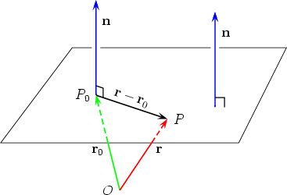
Planes in Space
Plane Determined by a point and a Normal Vector
a (X – Xo) + b ( Y – Yo) + c ( Z – Zo)
(point normal form of the equation of the plane)
Given the point Po(Xo , Yo , Zo) and vector
n = < a , b , c >perpendicular to the plane
Example:
Find an equation of the plane passing through the point (3, -1, 7) and perpendicular to the vector n= < 4, 2, -5>

Slide 64
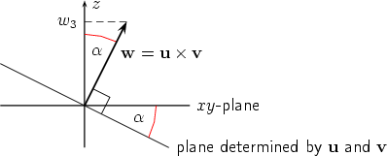
Intersecting Planes ( Angle between Two Planes)
condition : angle must be greater than or equal to 0˚ and less than or equal to 90˚
cosØ = __| n₁ · n₂|__
||n₁|| ||n₂||
Example: Find the acute angle of intersection between the two planes
2x – 4y + 4z = 6 and 6x + 2y -3z = 4

Slide 65
Distance Problems Involving Planes
Three basic problems in 3 – space
Distance between a point and a line
Distance between two parallel plane
Distance between two skew lines
Theorem: the distance D a point P0 ( x₀, y₀, z₀) and the plane ax + by + cz + d = 0 is
D= | ax₀ + by₀ +cz₀ + d |
( a² + b² + c² )^{1/2}
Example: Find the distance D between the point (1, -4, -3) and the plane
2x – 3y + 6z = -1

Slide 66
cALCULUs of vector valued function

Slide 67
Integration of Vector Valued Function
Ex. 1 ∫ (sin t)i + 2t j - 8t^3 k dt
Ans. ∫(-cost + c1)i + ∫ (t^2 + c2)j + ∫ (2t^4 + c3)k
Ex.2 ∫Q(t) = 2sin3ti – 4cos2tj + 3tk
Ans. ∫(-2cos3t/3)i - ∫(2sint)j + ∫(3t^2/2)k+c

Slide 68
Integration of Vector Valued Function
Ex. 3 ∫r(t) = <ti, cos2tj, sin2tk>
Ans. <π^2/2i, 0j, 0k>

Slide 69
Integration of Vector Valued Function
Ex. 4 ∫r(t) = <sin(t), 6, 4t>
a=0, b=1
Ans. <1-cos(1), 6, 2>

Slide 70
IMPROPER INTEGRALS

Slide 71




INTGRALS OVER UNBOUNDED INTERVALS
* Evaluate the following improper integrals and tell whether it converges or diverges.
Example 1:
Example 2:
Answer:
= 0
Converges
Answer:
= ln 2
Converges
Example 3:
Example 4:
Answer:
= 1/3
Converges
Answer:
= 1
Converges

Slide 72




* Evaluate the following improper integrals and tell whether it converges or diverges.
Example 5:
Example 6:
Answer:
= 1/2
Converges
Answer:
Diverges
Example 7:
Example 8:
Answer:
= -1/4
Converges
Answer:
Diverges

Slide 73
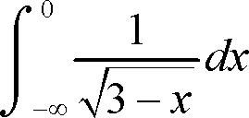

* Evaluate the following improper integrals and tell whether it converges or diverges.
Example 9:
Example 10:
Answer:
Diverges
Answer:
=-1/2
Converges
Example 11:
Answer:
Diverges

Slide 74






Integrals of Unbounded Functions
Examples:
1.
2.
3.
4.
5.
6.

Slide 75






7.
8.
9.
10.
11.
12.

Slide 76
Applications
On
Improper integrals

Slide 77


1. Let Ω be the region bounded by the curve y= and the x-axis x ≥ 0.
(a) Sketch Ω.
(b) Find the Area of Ω.
(c) Find the Volume obtained by revolving Ω about the x-axis.
(d) Find the Surface Area of the configuration in part (c).

Slide 78


Answers:
(a)
x
y
(b)1 square meters
cubic meters
(d) + ln(1 + )]

Slide 79

2. Let Ω be the region bounded
by the coordinate axes, the
curve y =
and the line x= 1.

Slide 80
(a) Sketch Ω.
x
y
(b) Show that Ω has finite area and find it.
Ω = 2 square units

Slide 81


Examples for Volume Applications of Improper Integrals
1.) Let “Ω” be the region bounded by the curve
Find the volume obtained by revolving “Ω” about the x-axis.
and the line x = 1.
Answer: π/3 cubic units.
2.) Find the volume of the solid generated by revolving around the y-axis the
curve
and the x-axis, x≥0.
Answer: 2π cubic units.

Slide 82


Examples:
3.) Find the volume obtained by revolving about the y-axis the region bounded by
the curve and the x-axis, 0<x≤1.
Answer: 2π cubic units.
4.) Find the volume of the ellipsoid you obtain when you revolve the ellipse
about the y-axis
Answer: 16π/3 cubic units.

Slide 83

Examples:
5.) Determine whether the volume obtained by revolving about the x-axis
the region bounded by the curve and the line x=e has an infinite volume
Answer: ∞ (infinite volume)

Slide 84
QUADRIC SURFACES

Slide 85
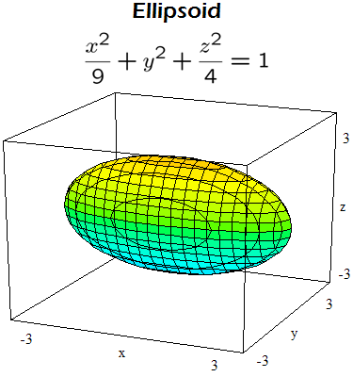
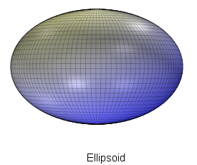
Quadric surfaces Draw the figure of the quadric surfaces. x² + 4y² + 9z² = 36

Slide 86
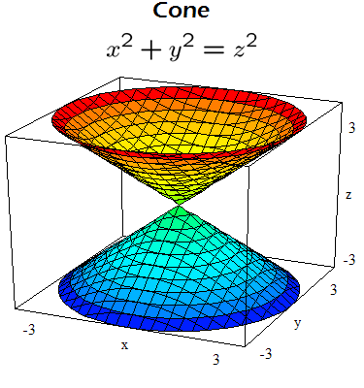
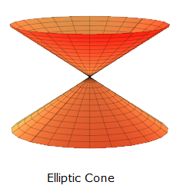
Draw the figure of the quadric surfaces.
9x² + 4y² - 36z² = 0

Slide 87
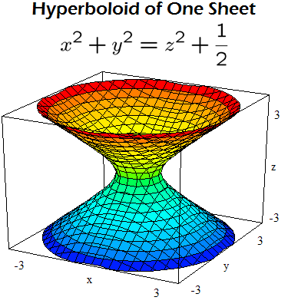
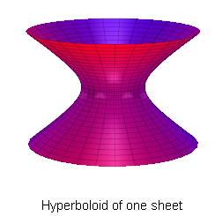
Draw the figure of the quadric surfaces. x² + y² - z² = 9

Slide 88
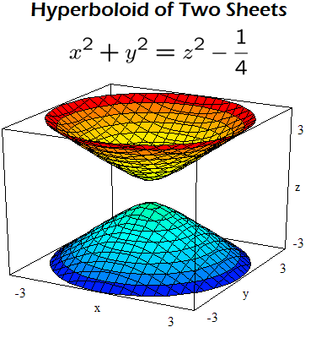
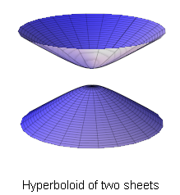
Draw the figure of the quadric surfaces. 9z² - 4y² - 9x² = 36

Slide 89
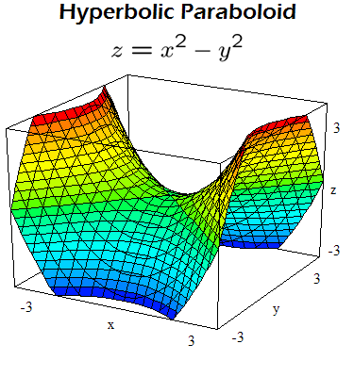
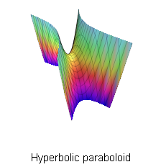
Draw the figure of the quadric surfaces. 9x² + 4y² = 36z

Slide 90
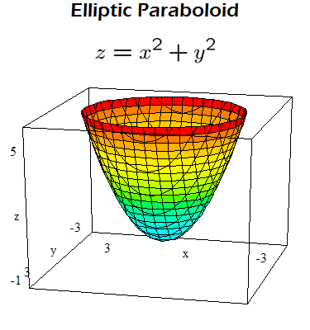
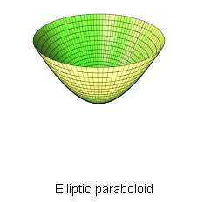
Draw the figure of the quadric surfaces. 4z = x² + 4y²

Slide 91
Level Curves
f( x,y) = x²+y²+2
for k = 2, 3, 4, 5, 6

Slide 92
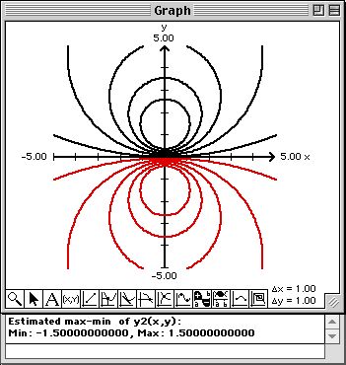
f(x, y) = -3y/(x²+y²+1) k = 0, 1, 2, 3, 4, 5

Slide 93
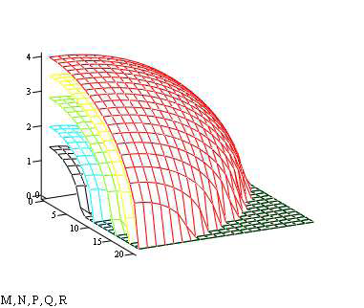
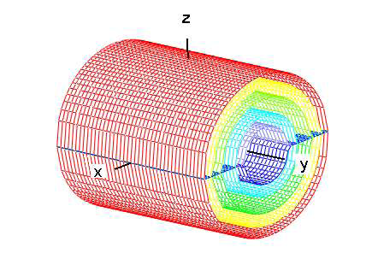
LEVEL SURFACES
Example 1
f(x,y,z) = x2 +y2 +z2.
Here the Level surfaces are concentric spheres centered at the origin.
As we move away from the origin the temperature increases and the spheres become closer. The
temperature increases at an increasing rate. Here the surfaces corresponds to f = 4,8,12,and 16.
Example 2
f(x,y,z) = x2 +z2 , the level Surfaces are the concentric cylinders x2 +z2 = c with the
main axis along the y- axis. With some adjustments of constants these level surfaces could
represent the electric field of a line of charge along the y axis. Here we have f = 2,4,8,12, and 16.

Slide 94
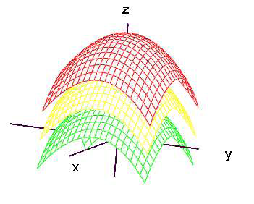
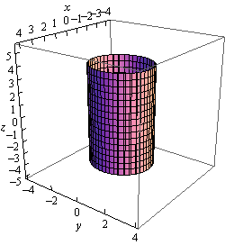
Example 3 f(x.y,z) = x2 +y2 +z . The level surfaces are the parabaloids z = c - x2 -y2 .
Example 4
Graph x2+y2=4

Slide 95
PARTIAL DERIVATIVES

Slide 96

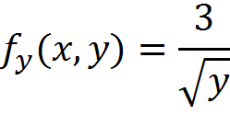

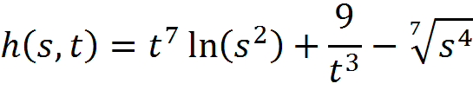
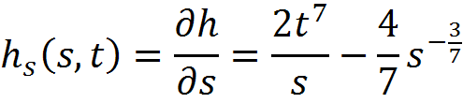
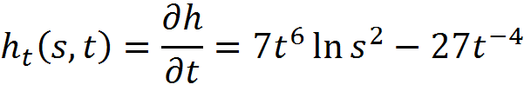
Partial Derivatives (Functions Of Two Variables)
1)
and
2)
and

Slide 97


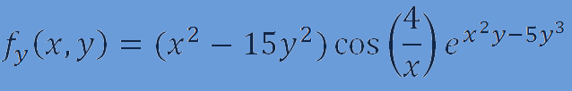
3)
and

Slide 98

Functions of Three Variables sample problem
1.Simplify
2.Solve the three variable equations.
p + q + r = 6 , 2p - q + 3r = 9 , -p + 2q + 2r = 9
3. Solve the functions of three variables is
f(x, y, z) = x² +y + 3z + 5. When x = 2, y = 5 and
z = 7.
4. Solve the three variable equations.
p + q + r = 6 , 2p - q + 3r = 9 , -p + 2q + 2r = 9

Slide 99
5. P and Q can do a piece of work in 12 days ; Q and R can do it in 20 days. In how many days will P, Q and R finishes it working all together? Also, find the number of days taken by each to finish it working alone?
6. Solving the following system of linear equations and then find the solution for the variables j, k, l.
4j+2k+3l=1
2j-3k+5l=-14
6j-k+4l=-1
7. The three variable equations are,
2x – y + 3z = 12
x + y – 2z = -3
5x – y = 9
Solving the equation by using substitution method.
8. Use elimination to solve the following system of three variable equations.4x + 2y – 2z = 10
2x + 8y + 4z = 32
30x + 12y – 4z = 24

Slide 100
Equation of Tangent Line
and Normal Plane to a surface
Let P(x_{o}, y_{o}, z_{o}) be a point on the graph of F(x, y, z).
The tangent plane at this point is the plane that passes through the point P, and the normal vector of the tangent plane is (F_{x}, F_{y}, F_{z}). So the equation of the plane is:
m₁(x - x_{o}) + m₂(y - y₀) + m₃(z - z₀) = 0
Where:
m₁=F_{x}
m₂=F_{y}
m₃=F_{z}

Slide 101
Equation of Tangent Line
and Normal Plane to a surface
Let P(x_{o}, y_{o}, z_{o}) be a point on the graph of F(x, y, z).
The normal line is line that passes through the point P and is perpendicular to the tangent plane. The symmetric equations of the line are:
(x - x_{o}) / m₁ = (y - y_{o}) / m₂ = (z - z_{o}) / m₃
Where:
m₁=F_{x}
m₂=F_{y}
m₃=F_{z}

Slide 102
Equation of Tangent Line
and Normal Plane to a surface
Example:
Find an equation of the tangent plane and parametric equations of the normal line to the graph of x² - 4y² + z² = 16 at (2, 1, 4).
F(x, y, z) = x² - 4y² + z² - 16
F_{x} = 2x = 2(2) = 4
F_{y} = -8y = -8(1) = -8
F_{z} = 2z = 2(4) = 8
tangent plane : 4(x - 2) - 8(y - 1) + 8(z - 4) = 0
normal line : (x - 2) / 4 = (y - 1) / (-8) = (z - 4) / 8

Slide 103
Equation of Tangent Line
and Normal Plane to a surface
Example:
Find an equation of the tangent plane and parametric equations of the normal line to the graph of x³ + 5y² - 7xy + z = 0 at (3, -1, 6).
F(x, y, z) = x³ + 5y² - 7xy + z
F_{x} = 3x2 - 7y = 3(3)² - 7(-1) = 34
F_{y} = 10y - 7x = 10(-1) - 7(3) = -31
F_{z} = 1
tangent plane : 34(x - 3) – 31(y+1) + (z - 6) = 0
normal line : (x - 3) / 34= (y + 1) / (-31) = (z - 6)

Slide 104
EXAMPLES OF HIGHER-ORDER PARTIAL DERIVATIVES
Let f(x,y)=y²e^{x}+y. Find f_{xyy}
ANS:

Slide 105




Find the second-order partial derivatives of
f(x,y)=x²y³+x⁴
ANS:

Slide 106
MAXIMA AND MINIMA

Slide 107
Example: Find the relative extrema of the function.
1.f(x,y)=6-x^2-4x-y^2
Solution:
(get the partial derivative) (Let fx=0 & fy=0 to get the critical point)
fx=-2x-4 2x-4=0 -2y=0
fy=-2y x=-1 y=0 critical point(-2,0)
(get the secod partial derivative)
fxx=-2 fyy=-2
fxy=0 fyx=0
D(x,y)=fxxfyy-(fxy)^2
D(-2,0)=(-2)(-2)-0=4>0
Relative maximum at (-2,0)

Slide 108
2.f(x,y)=2x^3+y^2-9x^2-4y+12x-2
Solution:
(get the partial derivative) (set fx and fy equal to zero to get the critical point)
fx=6x^2-18x+12 6(x^2-3x+2)=0 2y-4=0
fy=2y-4 (x-2)(x-1)=0 y=2
x=2 x=1
critical points:(2,2) & (1,2)
(get the second partial derivative)
fxx=12x-18 fyy=2
fxy=0 fyx=0
D(x,y)=fxxfyy-(fxy)^2
D(1,2)=-6(2)-0=-12<0 D(2,2)=6(2)-0=12>0
fxx(1)=12(1)-18=-6 fxx(2)=12(2)-18=6>0
Saddle point Relative minimun at (2,2)

Slide 109
Volumes of Solids with Known Cross Sections

Slide 110
Example 1
Find the volume of the solid whose base is the region inside the circle x² + y² = 9 if cross sections taken perpendicular to the y-axis are squares
Ans: V = 144 cubic units

Slide 111
Example 2
Find the volume of the solid whose base is the region bounded by the lines x + 4 y = 4, x = 0, and y = 0, if the cross sections taken perpendicular to the x-axis are semicircles. Ans: V = cubic units

Slide 112
MULTIPLE INTEGRALS

Slide 113
Evaluation of double integrals

Slide 114
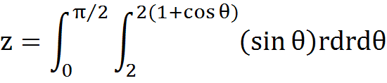

DOUBLE INTEGRALS
Evaluate:
Answer:

Slide 115

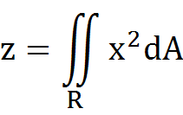
DOUBLE INTEGRALS
Evaluate using double integral in two ways using iterated integrals:
R is bounded by y = 16/x,
y=x, and x=8
Answer: z = 576

Slide 116
EVALUATION OF TRIPLE INTEGRALS

Slide 117
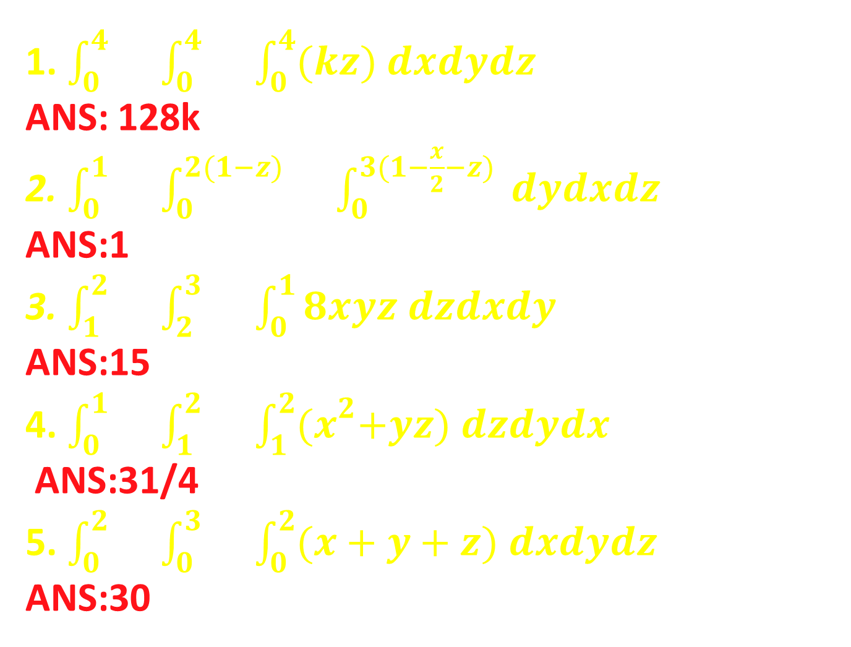
1. $\int_{0}^{4}{}\int_{0}^{4}{}\int_{0}^{4}{(kz) dxdydz}$ ANS: 128k 2. $\int_{0}^{1}{}\int_{0}^{2(1−z)}{}\int_{0}^{3(1−\frac{x}{2}−z)}{ dydxdz}$ ANS:1 3. $\int_{1}^{2}{}\int_{2}^{3}{}\int_{0}^{1}{8xyz dzdxdy}$ ANS:15 4. $\int_{0}^{1}{}\int_{1}^{2}{}\int_{1}^{2}{{(x}^{2}+yz) dzdydx}$ ANS:31/4 5. $\int_{0}^{2}{}\int_{0}^{3}{}\int_{0}^{2}{(x+y+z) dxdydz}$ ANS:30

Slide 118
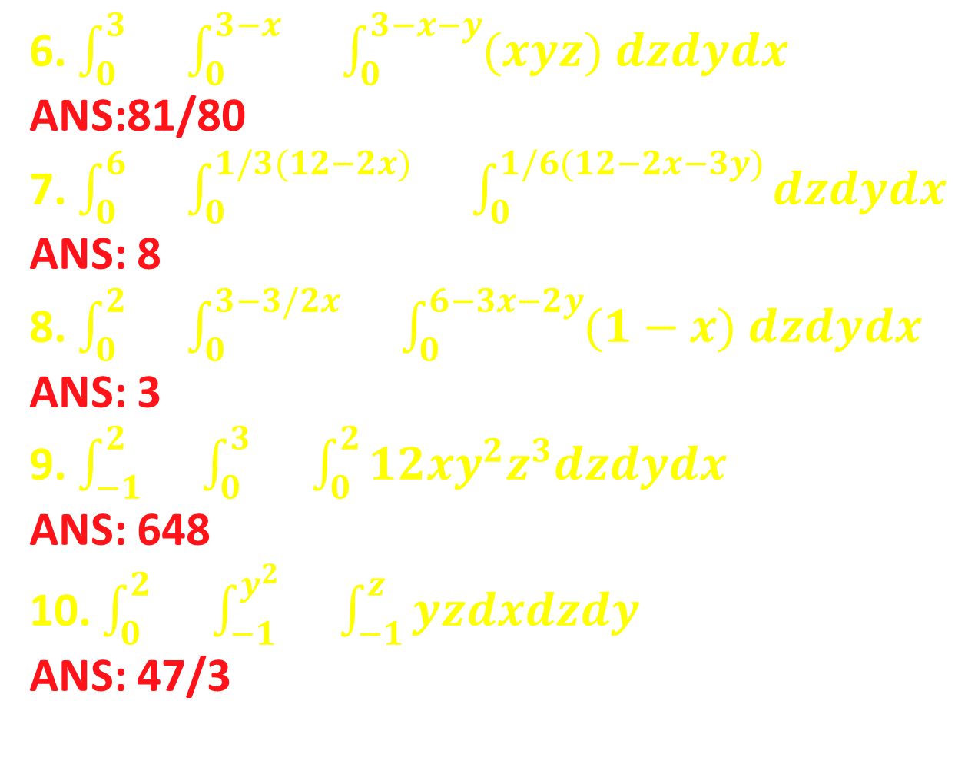
6. $\int_{0}^{3}{}\int_{0}^{3−x}{}\int_{0}^{3−x−y}{(xyz) dzdydx}$
ANS:81/80 7. $\int_{0}^{6}{}\int_{0}^{1/3(12−2x)}{}\int_{0}^{1/6(12−2x−3y)}{dzdydx}$ ANS: 8 8. $\int_{0}^{2}{}\int_{0}^{3−3/2x}{}\int_{0}^{6−3x−2y}{(1−x) dzdydx}$
ANS: 3 9. $\int_{−1}^{2}{}\int_{0}^{3}{}\int_{0}^{2}{12xy^{2}z^{3}dzdydx}$
ANS: 648 10. $\int_{0}^{2}{}\int_{−1}^{y^{2}}{}\int_{−1}^{z}{yzdxdzdy}$
ANS: 47/3

Slide 119
INFINITE SERIES

Slide 120




Divergence Test
Apply Divergence Test;
1, Ans. = Diverges
2. Ans. = Diverges
3. Ans. = Diverges
4. Ans. = Diverges

Slide 121




Divergence Test
Ans. = Diverges
Ans. = Diverges
Ans. = Diverges
Ans. = may either converge or diverge

Slide 122



Examples of Integral Test
: The series Diverges
: The series Converges
The series Diverges :

Slide 123


: The series Diverges
The series Diverges :
Vina Korina M. Solidum Math23/A3

Slide 124
Comparison Test
By Comparison Test the following series were proven to be convergent:

Slide 125
By Comparison Test the following series were proven to be divergent:

Slide 126
LIMIT COMPARISON TEST

Slide 127
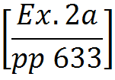
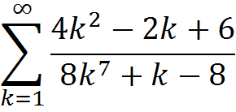
Use the Limit Comparison Test to determine if the series converges or diverges
Answer: The series converges.

Slide 128
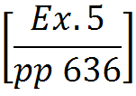
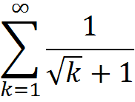
Use the Limit Comparison Test to determine if the series converges or diverges
Answer: The series diverges.

Slide 129
The Root Test

Slide 130




Examples:
$$\sum_{k=1}^{∞}{{\left(\frac{3k+2}{2k−1}\right)}^{k}}$$
1.
$∴$ The Series Diverges
$$\sum_{k=1}^{∞}{{\left(\frac{k^{1−k}}{5^{k}}\right)}^{k}}$$
2.
$∴$ The Series Converges

Slide 131
THE RATIO TEST

Slide 132



Slide 133
Alternating Series

Slide 134


Example No. 1
Consider the series…
This series converges.

Slide 135

Example No. 2
Consider the series…
This series converges.

Slide 136
ABSOLUTE CONVERGENCE

Slide 137



ABSOLUTE CONVERGENCE: Show that the following converges absolutely

Slide 138




